Slide 1

PROCESS MINING VIRTUAL INTERNSHIP BY J.SATHEESH REDDY 234G5A3208
DEPARTMENT OF COMPUTER SCIENCE &ENGINEERING
SRINIVASA RAMANUJAN INSTITUTE OF TECHNOLOGY
Autonomous
Rotarypuram Village, B K Samudram Mandal, Ananthapuramu – 515701.
2024-2025

Slide 2
contents
Introduction
What is Process Mining & how it works
Applications of process mining
conclusion

Slide 3

Introducton
We have done this internship under Eduskills in association with AICTE. We have done this in 2 months of duration.
The process mining was done in the platform of Celonis website, it helps companies achieve process excellence through its platform by eliminating operational friction with their Intelligent Business Cloud platform.
Celonis is an American-German data processing company that offers software as a service (SaaS) to improve business processes
Process Mining is a powerful tool that can help you uncover hidden insights in your business processes.

Slide 4
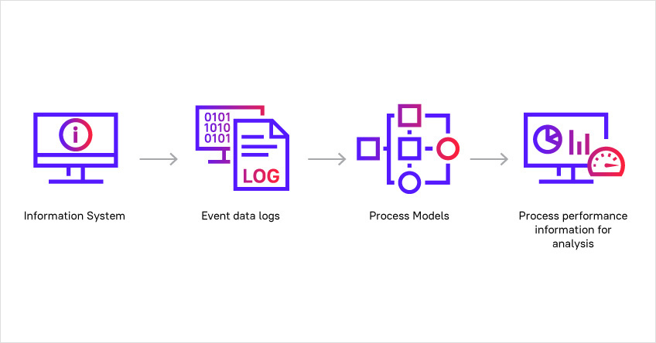
WHAT IS PROCESS MINING & HOW IT WORKS
Process mining is a technique designed to discover, monitor and improve real processes (i.e., not assumed processes) by extracting readily available knowledge from the event logs of information systems.
figure that explains how process mining works actually.

Slide 5
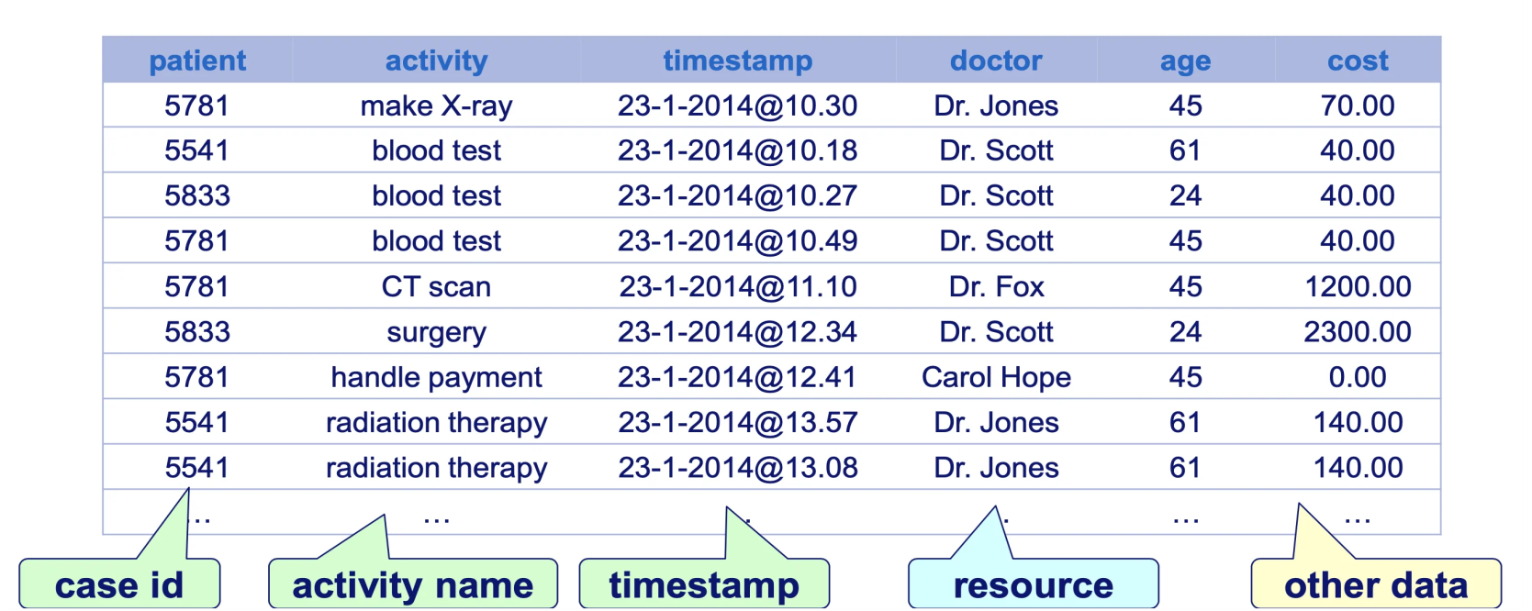
EVENT LOGS
Event logs are defined using Activity tables that contain the Activity, Case and Timestamp data.
Ex:

Slide 6
Process Model
There are three main categories of process mining:
1) process discovery,
2) conformance checking, and
3) process enhancement.
Process Discovery:
Business process discovery is a process mining technique used to create a data-based visualization of process workflows. Using data found in event logs, process mining automatically generates a discovered model for analysis, giving users a visual and unbiased representation of their business processes.

Slide 7
Conformance check: Conformance checking is a method of comparing the execution of a business process against a predefined set of conditions, such as a business process model. Process Enhancement check: Process enhancement, sometimes referred to as model enhancement, is a process mining technique that's used to extend or enhance a target model or reference model using discovered information about the actual process.

Slide 8
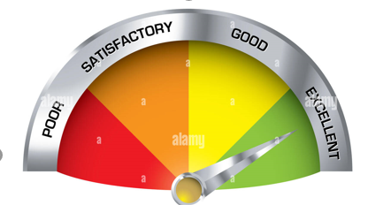
Process Performance Information
Typically, three dimensions of performance are identified: time, cost, and quality. For each of these performance dimensions, different Key Performance Indicators (KPIs) can be defined. The lead time (also referred to as flow time) is the total time from the creation of the case to the completion of the case.
process performance indicator

Slide 9
Applications of Process Mining
Health Care
Banking
Retail

Slide 11
conclusion
process mining is important because it helps organizations gain valuable insights into their operations, leading to improved efficiency, compliance, and decision-making.

